Slide 1
Special senses

Slide 2
Unit 1

Slide 3
Vision
The eye works as a special sense organ of vision, converting light rays into neural signals to form visual perception.

Slide 4
Protective structures
Structure | Function
Eye lids (palpebrae) | Protect the eye from injury & excessive light; spread tears over cornea
Eye lashes | Trap dust particles
Conjunctiva | Lubrication; prevents entry of microbes
Orbital cavity | Bony protection
Lacrimal apparatus | Produces and drains tears; moistens and nourishes cornea

Slide 5
Outer Fibrous Coat (For Protection & Shape)
Structure | Function
Sclera | White opaque coat maintaining shape; attachment for extraocular muscles
Cornea | Transparent anterior surface; main refractive (light bending) medium; avascular

Slide 6
Middle Vascular Coat (Uveal Tract – For Nutrition & Light Regulation)
Structure | Function
Choroid | Highly vascular; supplies oxygen & nutrients to retina; absorbs stray light
Ciliary body | Contains ciliary muscles and processes; accommodation (focus for near vision) & secretion of aqueous humor
Iris | Pigmented diaphragm with pupil; regulates light entry by changing pupil size

Slide 7
Inner Nervous Coat (For Photoreception)
Structure | Function
Retina | Contains photoreceptors—rods (dim light/black-white) & cones (bright light/color/visual acuity)
Macula lutea | Area of sharp central vision
Fovea centralis | Highest visual acuity; only cones

Slide 8
Refractive Media (Image Formation)
Refractive Media | Function
Cornea | Primary refractive surface
Aqueous humor | Maintains intraocular pressure (IOP); nourishes cornea and lens
Lens | Changes shape for accommodation; fine focusing
Vitreous humor | Maintains globe shape; supports retina

Slide 9
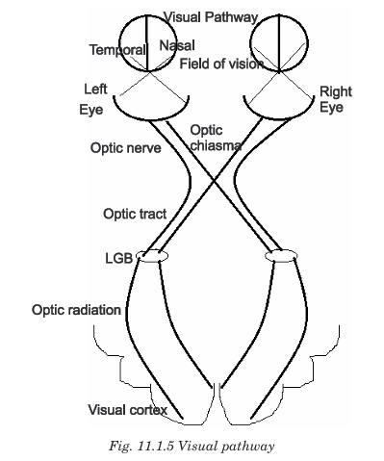

Slide 10
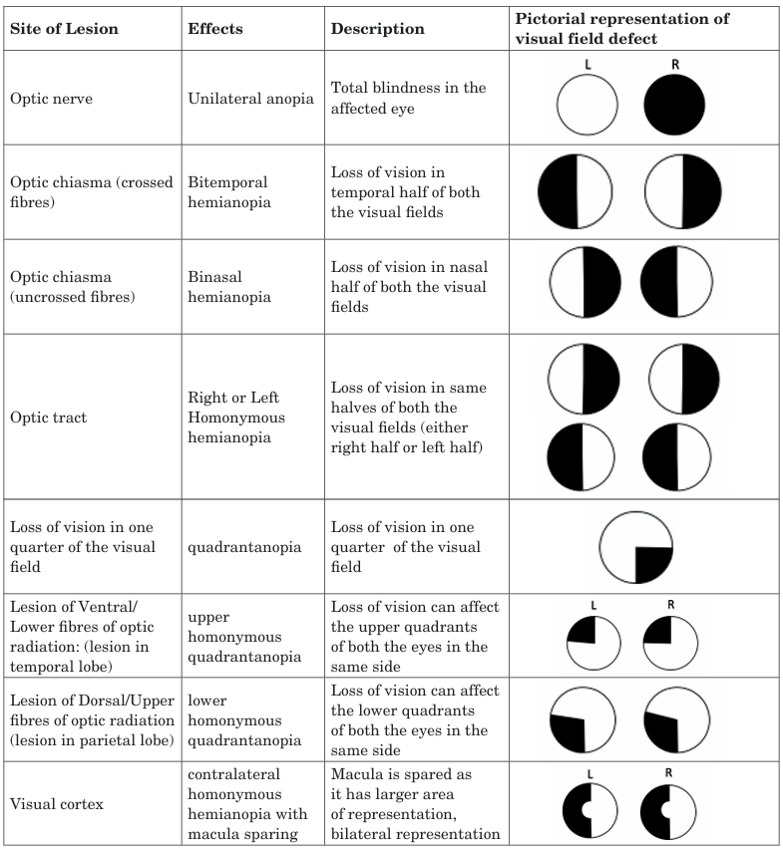

Slide 11
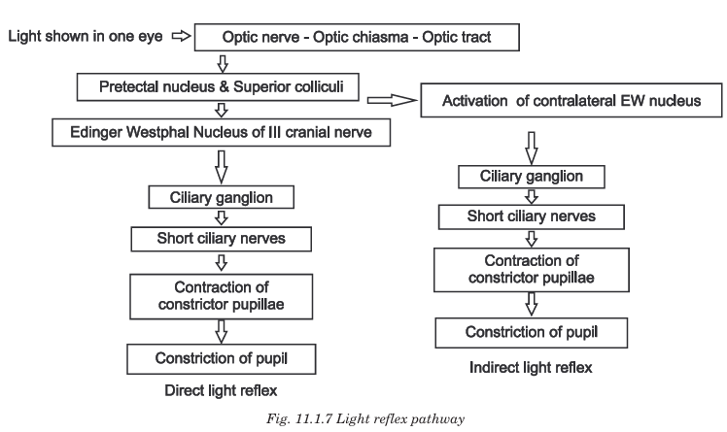

Slide 12
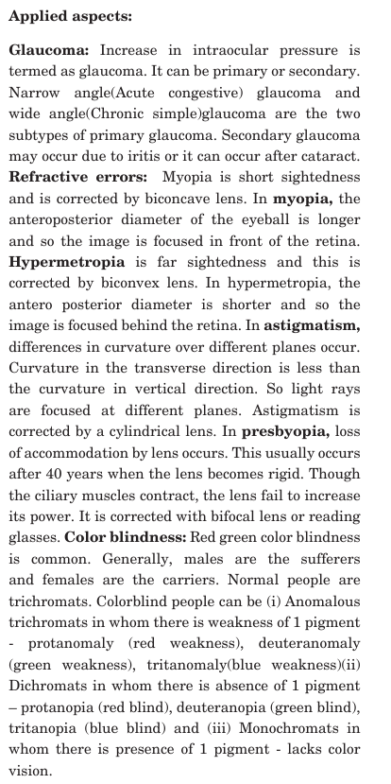

Slide 13
Unit 2

Slide 14
Hearing
Main Parts of the Ear
The ear is divided into three major parts:
1️⃣ External (Outer) Ear
2️⃣ Middle Ear
3️⃣ Internal (Inner) Ear
Each part has structures that perform different functions.

Slide 15
External Ear (Outer Ear)
Parts
Pinna (Auricle)
External Auditory Canal
Tympanic Membrane (Eardrum)
Structure | Function
Pinna | Collects sound waves from the environment
External Auditory Canal | Transfers sound waves to the eardrum; contains wax to trap dust
Tympanic Membrane | Vibrates when sound hits it, converting sound waves into mechanical vibrations

Slide 16
Middle Ear
Parts
Ossicles (3 small bones):
  Malleus (Hammer)
  Incus (Anvil)
  Stapes (Stirrup)
Eustachian Tube
Oval Window
Structure | Function
Ossicles (Malleus, Incus, Stapes) | Amplify and transmit vibrations from eardrum to inner ear
Stapes / Oval Window | Sends vibrations into fluid of inner ear
Eustachian Tube | Balances pressure between middle ear and atmosphere (connects to throat)

Slide 17
Internal Ear (Inner Ear / Labyrinth)
Divided into:
Cochlea (Hearing part)
Vestibular apparatus (Balance part)
Structure | Function
Cochlea | Converts vibrations into nerve impulses using hair cells
Organ of Corti | Sensory organ of hearing inside cochlea; contains mechanoreceptors
Vestibule & Semicircular Canals | Detect head position and movement; maintain balance
Vestibular Nerve & Cochlear Nerve | Carry signals to brain (balance & hearing respectively)

Slide 18
Mechanism of Hearing (Step-by-Step Process)
Collection of Sound Waves
Vibration of Tympanic Membrane
Amplification by Ossicles
Wave Formation in Cochlear Fluid
Stimulation of Hair Cells (Organ of Corti)
Transmission to the Brain
Perception of Sound

Slide 19
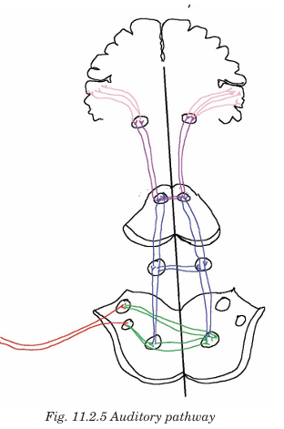

Slide 20
Unit 3

Slide 21
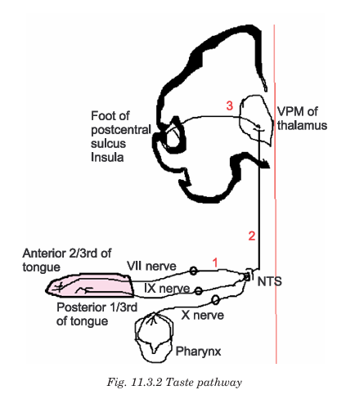

Slide 22
